Slide 1

Task - 2
Predicting customer buying behaviour

Slide 2
Predictive modelling:
In the target column, one feature is sparse and other one is dense. So, by using SMOTE we can add some synthetic data to make a balanced data.
Before using SMOTE: After using SMOTE : F1-score (train) : F1-score(test) :
0 42522 0 42522 1.00 0.90
7478 1 42522 1.00 0.89
Random Forest and Bagging Classifier gave the highest accuracy in both train and test data :
-Accuracy (Random Forest) on training data: 0.99
-Accuracy (Random Forest) on test data : 0.894
Using Cross-Validation the mean and standard deviation of the Random Forest classifier is best for our hyperparameter tuning : F1-score (train): F1-score(test) :
0 - 0.95 0 - 0.90
1 - 0.95 1 - 0.88
Accuracy (Random Forest tuned) on training data: 0.949
Accuracy (Random Forest tuned) on test data : 0.89

Slide 3
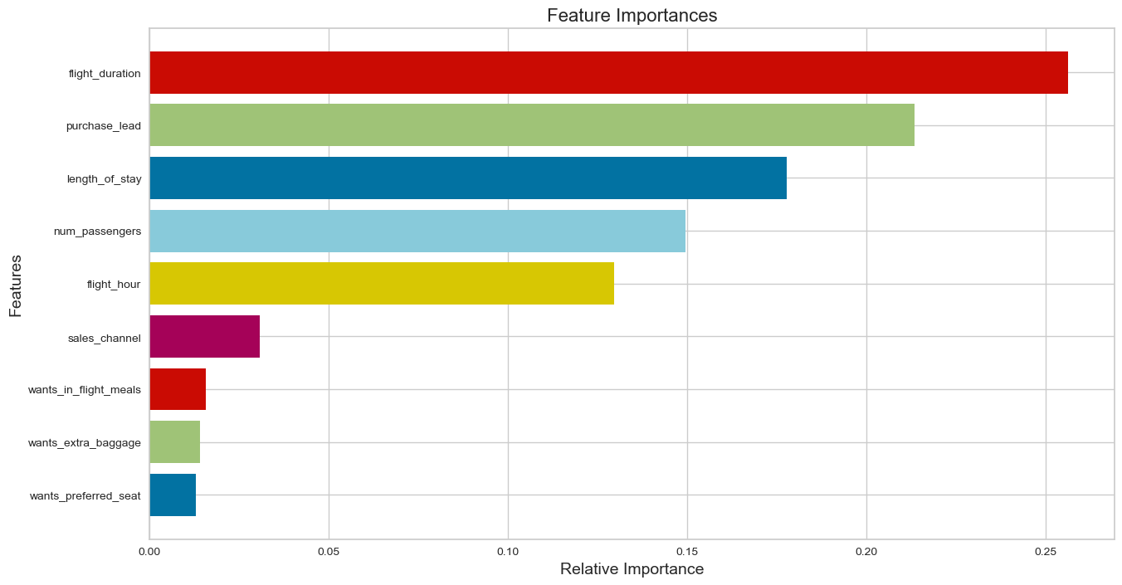
Features Selected in Predictions :

